Slide 1
Identity Management as a Business Enabler
Miroslav Jeličić

Slide 2
Agenda
Beta Systems – the company at a glance
Identity Management as a Business Enabler or “all you wanted to know about IdM/IAM and never had a chance to ask”
Garancy IAM, Identity Management by Beta Systems, at a glance
Q & A
Garancy IAM demo

Slide 3


Beta Systems at a glance
1983
Year of Foundation
1997
IPO
38 years
of experience
7
R&D sites
26
Companies worldwide
More than
670
employees
3.500
Customers worldwide
6.000
Installations
€70 Mio.
Revenue in FY 2019/2020

Slide 4

Beta Systems Software
IAM | Identity
& Access Management
DCI | Data Center Intelligence
Auconet BICS
BICS: Business Infrastructure Control System
Network Security Management
System Management
Asset Management
Network Management
Data Center Solutions
Access Management
Log Management
Output Management
Operlog Tools
Job Scheduling
Garancy IAM
Provisioning
User Center
Recertification
Center
Password Management
Access Intelligence
HORIZONT
IWS products
X-Info
Smart JCL
ProcMan

Slide 5
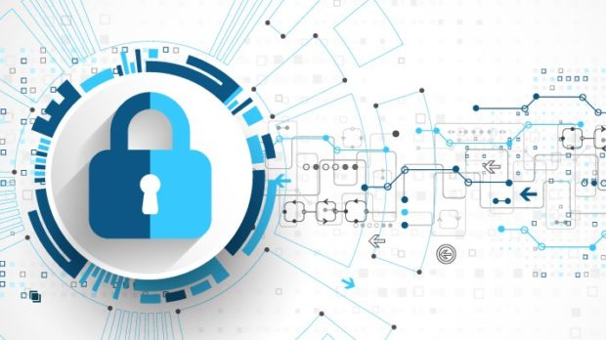
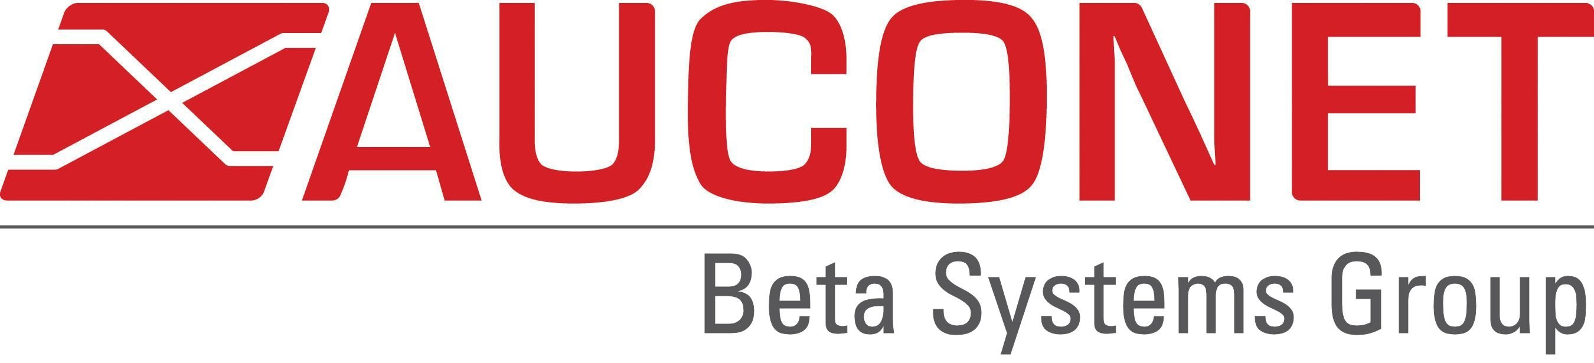
Beta Systems Solutions:
Part of a Comprehensive Security Architecture
Security
Orch. and Response
Virus
Scanner
Firewall
AdvancedThreat
Detection
IPS
Garancy
IAM
BICS
Notes:
It would be a bit overstated to claim that BICS can ward off all this cyberattacks single-handedly. Actually, a good security architecture comprises a set of applications, there’s no single security product that will make a company safe.
And BICS is an important component in a company’s security architecture

Slide 6
What is Digital Identity of a person?
Digital Identity is the set of information that represent a person in an acceptable and trusted digital format in computer systems
Zero trust, work from home, cloud architecture, customer experience, digital transformation, … they all have Identity Management, Identity Administration and Identity Governance in common
Therefore, Identity, to be precise, Digital Identity, is the new security perimeter

Slide 7
What is Identity Management? What is it good for?
Identity Management is the set of business processes and supporting IT tool for the creation, maintenance, and use of trusted digital identities to enable the right individuals (WHO) to access the right resources (WHAT) at the right times (WHEN) for the right reasons (WHY)
  Automates identity/employee life-cycle
  Prevents insider threats
  Shrinks the attack surface
  Improves employee productivity
  Enhances user experience while keeping company resources safe
Identity management is the first brick in building a zero-trust network

Slide 8
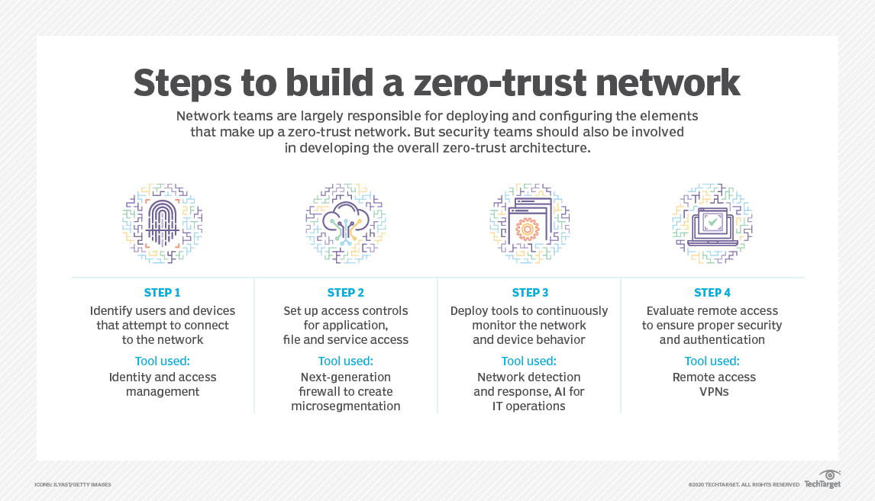
Identity Management & Zero-Trust

Slide 9

Prevention - there’s no such thing like “a small security gap”!
Source: UnderDefence (www.underdefence.com)

Slide 10
The Life Cycle of Users and their Access Rights
Number of
Access Rights
Onboarding of a
new user …
…starts
a new project,
...the project
ends,
... is moved to a
new position / job function
...and leaves
the organization
30% of users and their
access rights remain active
after leaving a company.
Time
Automation and Productivity the same day
Efficient
Workflows
Security:
No cumulation
of Access Rights
Automated processes
when moving position
Security by immediate
handling of access rights
Access Right profile with manual administration
Access Right profile with Identity & Access Management
Notes:
Zu jeder Zeit per Knopfdruck nachzuvollziehen wer wem, welche Berechtigungen gegeben hat.

Slide 11
Identity & Access Management
With IAM, companies keep control of all user access rights in all systems
Governance of User Access Rights via automated rules or workflow applications
Provisioning of User Access Rights
to enterprise-wide platforms and applications.
Reconciliation and control of actual Access Rights vs. the governed target values
Analytics and Recertification of
actual access rights and governance rules
Identity
& Access
Management

Slide 12
Automated Provisioning - Access Rights by HR data
E
HR knows the employee's job description
Based on HR attributes (job title, organizational unit), entitlements are assigned to users
Access rights in all connected IT-Systems are managed by Identity & Access Management
Access rights of employees who change position, will automatically be corrected.
Employee
Data
job title
org. unit
HR
Identity & Access
Management
IAM
Access
Rights
Access
Rights
Notes:
+4

Slide 13

Workflows - Involving the Business Layer
Who can judge individual access rights requests?
With IAM Workflows, users can request specific access rights on their own
By configurable approval processes, managers will decide about the request
Access rights will be granted and managed automatically by the IAM system
All activities and approval steps are logged and preserved for later audits
Workflow-System
!
?
Business
Layer
?
Manager
Identity & Access
Management
IAM
Access
Rights
IT Dept.
Notes:
+5

Slide 14
From Technical Provisioning to Access Governance
Digital Transf.
Digital Transf.
Digital Transf.
Digital Transf.
Digital Transf.
Recertification
Recertification
Recertification
Recertification
Recertification
Self-Services
Self-Services
Self-Services
Self-Services
Self-Services
Roles & Rules
Roles & Rules
Roles & Rules
Roles & Rules
Roles & Rules
Provisioning
Provisioning
Provisioning
Provisioning
Provisioning
Traceability/
Security
Business
Enablement
Efficiency
Speed
Compliance

Slide 15

Efficiency – The Initial Driver for Provisioning
Instead of an access right administration per system,
central provisioning to all systems saves time and resources.
Higher Admin Speed
Lower Admin Costs
Less Expertise needed
Higher Accuracy
Less errors
...
Admin
Identity Provisioning
Admin
Admin
Admin
Admin
Admin
Admin
LDAP
Windows
Mail-Server
Linux/Unix
Applications
Directories
Self-Made

Slide 16
Traceability – Prerequisite for Security
Individually assigned low level access rights’ are hard to understand
Role Based Access Control provides a better understanding.
Rule-based entitlement assignments are more secure and traceable.
Higher transparency
Business Orientation
Higher Efficiency
Higher Security
Role Management /
Rule-based entitlements
Identity Provisioning
LDAP
Windows
Mail-Server
Linux/Unix
Applications
Directories
Self-Made

Slide 17
Speed – Involving the Departments
Self-Service workflows accelerate the approval processes
and increase traceability and security additionally
Higher Speed & Flexibility
Business Orientation
Higher Efficiency
Higher Security
Self-Services &
Business Workflows
Role Management /
Rule-based entitlements
Identity Provisioning
LDAP
Windows
Mail-Server
Linux/Unix
Applications
Directories
Self-Made

Slide 18
Compliance – Implementing ‘Need to know’
To grow from self-service IAM to a compliant self-service IAM:
the Principle of Least Privilege (PoLP)
Segregation of Duties (SoD)
Fulfilling Compliance
Higher Accuracy
Higher Security
Self-Services &
Business Workflows
Self-Services &
Business Workflows
Recertification
SoD Control
Role Management /
Rule-based entitlements
Identity Provisioning
LDAP
Windows
Mail-Server
Linux/Unix
Applications
Directories
Self-Made

Slide 19
Identity Management and Digital Transformation
As a consequence of the digital transformation, Identity Management becomes involved in many business aspects
Collaboration with external partners & teams (and increased WFH)
Operating in & connecting to the cloud (Azure, SalesForce, ServiceNow, …)
Get 360 degrees view of your customer by centralizing user data from different applications (one identity repository for all)
Secure platform for quick deployment of new products/services
Improves customers‘ experience (easy on-boarding, privacy, safe payments…)
…

Slide 20










Beta Systems Garancy IAM Suite
I
Garancy Portal
User Gateway
Process
Center
PRC
Recertification
Center
RCC
User
Center
USC
Access
Intelligence
Manager
AIM
Password
Management
PRE / PSY
Data
Access
Governance
DAG
Governance
Request & Approval Workflows
Lifecycle Management
User Self-Services
Audit & Reporting
Identity Manager
IDM
Provisioning
Central Repository
Rule- & Role Management
Batch-Process
SoD-Management
Target-System Connectivity
Online-/Offline-Connectivity
Standard Connectors and
Connector-Frameworks
Cloud-Systems & On-Premise
Fully bidirectional
Encrypted & compressed
Salesforce.com
ISAM
eSSO
LDAP
eConnect
MS Windows
RACF
ACF2
TopSecret
Series i
AIX
eSSO
MS Exchange
Lotus Domino
SAP
Linux
Oracle DB
Solaris
DB2
uConnect
19.04.2018

Slide 21




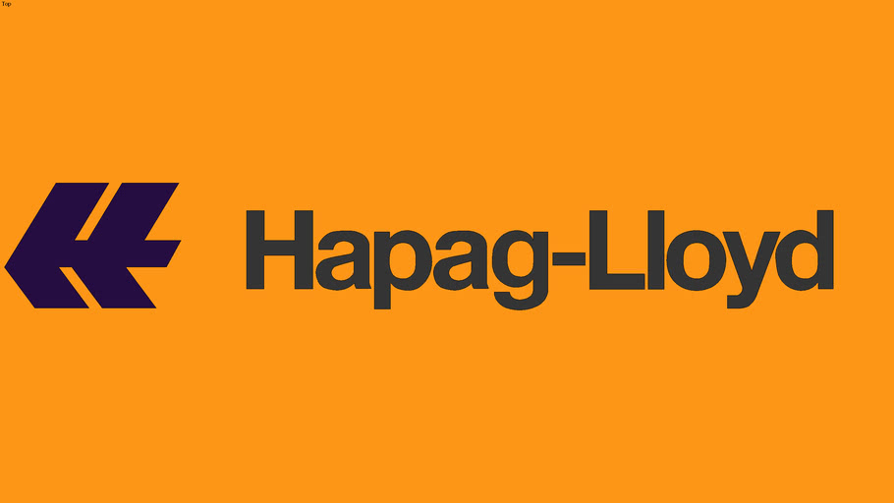








Garancy IAM Customers - from 200 to 300.000 users

Slide 22


Thank you for your attention!
Beta Systems Identity & Access Management
  360° A leading, full-blown IAM
  from provisioning to governance
  25+ years A reliable and scalable product
  combined with long-term expertise
  100% Successful project implementations
  ∅ 13.7 years Customer satisfaction
  with a close and long-term relationship
  Local Independent and European IAM Vendor
In case of questions, please contact me
miroslav.jelicic@betasystems.com
www.betasystems-iam.com

Slide 23
Further reading
KPMG & Beta Systems white papers (contact me)
IAM Introduction – white paper by Beta Systems (contact me)
Idenhaus blog (https://www.idenhaus.com/)
TechTarget blog (https://www.techtarget.com/blog/)
Beta Systems IAM blog (https://blog.betasystems-iam.com/)

Slide 24
Identity Management - frequently used terms
Identity - The subset of profile data that uniquely represents a person or entity
Identity Provisioning and Deprovisioning - The process of creating, managing and deleting digital identities in a computer system
IAM or IdM – Identity and Access Management or Identity Management
Governance - A set of rules that define the access rights of a user
Insider Threat - the threat that an employee, partner or a contractor will use her or his authorized access, wittingly or unwittingly, to do harm to the business
IGA – Identity Governance and Administration
Policy - A set of rules that influence the behavior of a user or a resource
Role – A logical group of principles that provide a set of permissions (a container of access rights). A role is closely related to job function
RBAC – Role Based Access Control
SoD – Segregation of Duties (toxic combinations or roles not allowed!)
PoLP – Principle of Least Privilege (or Need-to-Know-Principle)
Recertification - The process of validating user credentials, typically after a specified time interval
Workflow - The sequence of activities that is done in accordance with the processes of an organization
Access Intelligence - The process of gathering data about identity and access, and converting it to information and knowledge for action-oriented insight and intelligent decision making in IT and business
IDoT – IDentity of Things (Human Users vs. Technical Users)

Slide 25
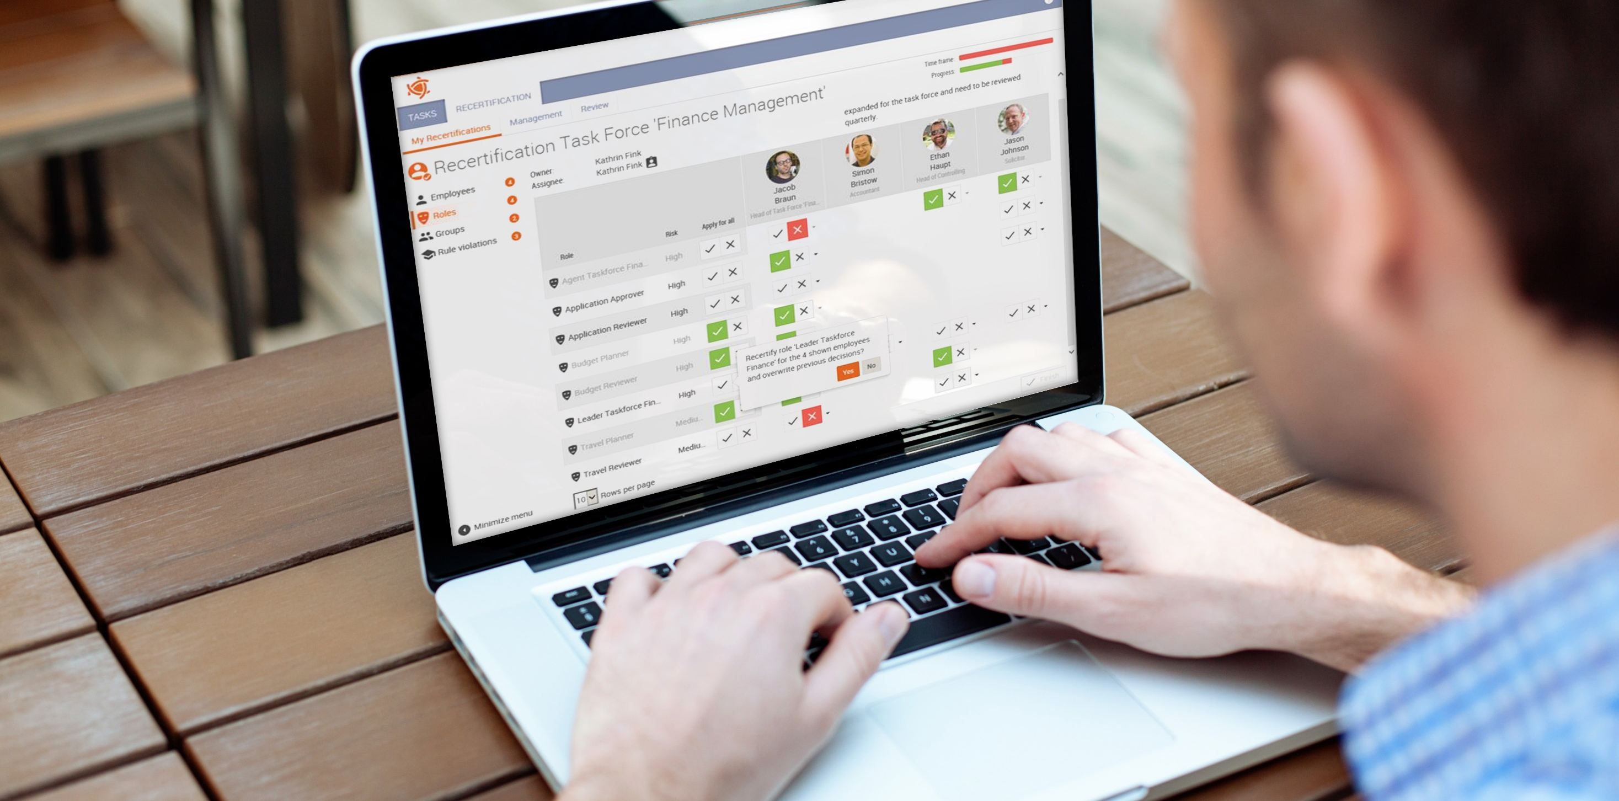
GARANCY IAM live demo by Ralf Hanselle

